Slide 1
SQL

Slide 2
Design a data model for a school

Slide 3
Q1) Find the number of unique days each employee worked Emp Id Task Id Start date End date 1 1 Monday Wednesday 1 2 Monday Tuesday 1 3 Friday Friday 2 1 Monday Friday 2 1 Tuesday Wednesday Hint: Calendar day table or date dimension table Calendar_day Calendar_day_of_week Calendar_year Calendar_month 1900/01/01 Wednesday (3) 1990 1

Slide 4
How many customers placed orders every month?
Table 1: Customer Date customer_id order_id units country 2019/07/01 A 112 5 US 2019/07/02 A 211 4 US 2019/08/02 B 511 4 EU 2019/09/01 C 322 1 JP 2019/09/01 C 322 2 JP 2019/08/05 A 378 6 US 2019/09/10 A 456 7 US

Slide 5
What is index ?
Indexes are used to retrieve data from the database more quickly than otherwise.
The users cannot see the indexes, they are just used to speed up searches/queries.
Can be non-unique.

Slide 6
Partition
We create function to partition data
It creates virtual tables.

Slide 7
What is a foreign key ?

Slide 8
Give example of joins

Slide 9
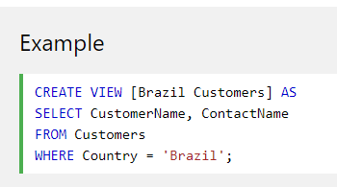
What is a SQL view ?
Virtual table.
Contents obtained from base tables using queries.

Slide 10
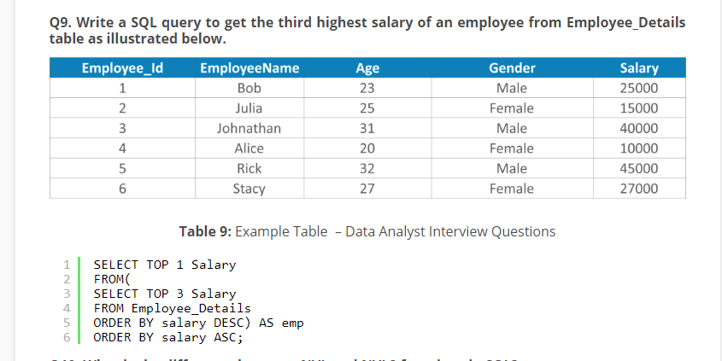
Write a query to get the third highest salary

Slide 11
Union & Union vs union all
We use union to combine datasets.
Order & number of the columns should be the same in both queries.
Union selects only distinct values, it will not include duplicates.
Union all selects all values. Duplicate rows are not eliminated.

Slide 12
What is a self join & when would you use it ?
Self-join is useful when you have to evaluate the data of the table with itself.
A common use case is when the table stores entities (records) which have a hierarchical relationship between them.
For

Slide 13
How to find duplicates in table ?
We can group by using a column & than we can use having clause to show the results where groups count is greater than 1.
Another way is to appky

Slide 14
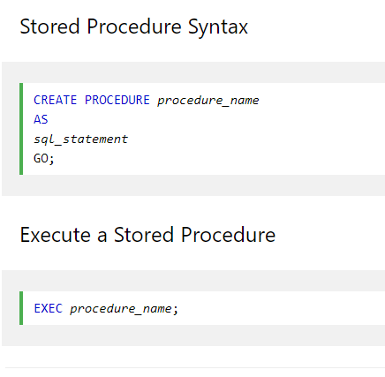
What is a stored procedure in SQL ?
Prepared sql code that we can save & execute & resuse.
Can be passed parameters.

Slide 15
What is the diff bw truncate & delete ?
The TRUNCATE command is used to delete all the rows from the table and free the space containing the table.
The DELETE command deletes only the rows from the table based on the condition given in the where clause or deletes all the rows from the table if no condition is specified. But it does not free the space containing the table.

Slide 16
Aggregate vs Scalar
An aggregate function performs operations on a collection of values to return a single scalar value. Usually used alongwith group by & having. For ex avg, count, max, min
Scalar function returns a single valuye based on input. Len(), Round()

Slide 17
What is a user defined function ?
The user-defined functions in SQL are like functions in any other programming language that accept parameters, perform complex calculations, and return a value. They are written to use the logic repetitively whenever required.
UDFs are a way to extend MYSQL with a new function that works like native in built functions.
They are of scalar function type
Table valued functions.

Slide 18
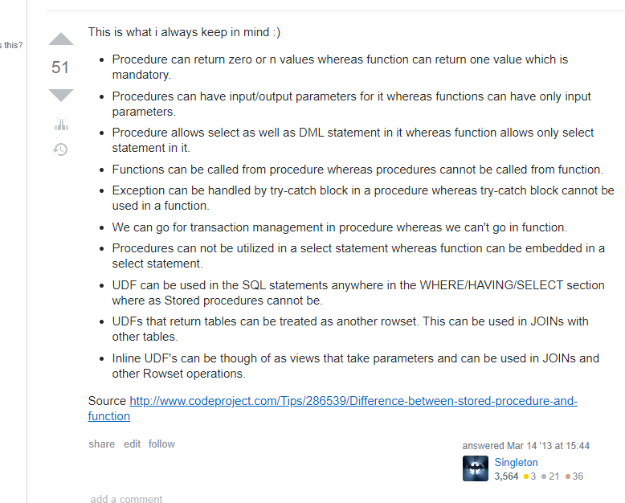
Procedures vs user defined functions
A function always return value & cannot perform data manipulation statements i.e. insert delete & update.

